Slide 1
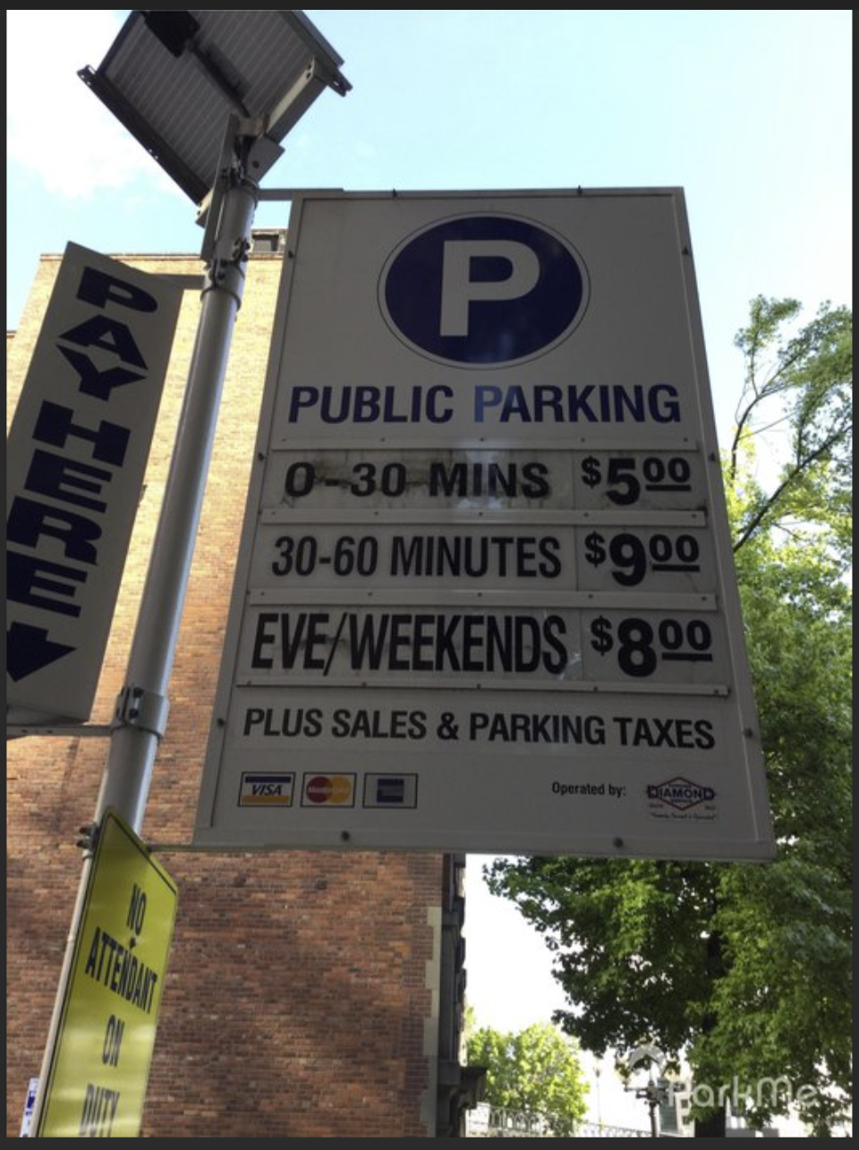
Seattle Parking Occupancy
Yogita Nesargi
Springboard Data Engineering Oct 2020

Slide 2
The Problem
Seattle Parking Occupancy
Public
The mission of data.seattle.gov is to provide timely and accurate City information to increase government transparency and access to useful and well-organized data by the general public, non-governmental organizations, and City of Seattle employees
Parking Occupancy data can be used to answer some of the following questions
Where can I find a parking spot near me?
Where is a street/block to find a parking spot right now? or in 1 hour?
How much will the parking cost?
Notes:
The mission of data.seattle.gov is to provide timely and accurate City information to increase government transparency and access to useful and well-organized data by the general public, non-governmental organizations, and City of Seattle employees
Seattle Parking Occcupancy Data is of interest to the public who can use to get information on the some of the following questions:
Where can I find a parking spot near me?
Where is a street/block to find a parking spot right now? or in 1 hour?
How much will the parking cost?

Slide 3

A Solution
Seattle Parking Occupancy Big Data Cloud Infastructure
Seattle Parking Occupancy Use the processed occupancy data and build a big data cloud infastructure to run analytics on the Parking occupancy data
Notes:
My proposed solution is building a big data cloud infastructure to run analytics on the Parking Occupancy Data

Slide 4

Architecture
Data Sources
2020 CSV file
18GB
2020 Seattle Street Parking Occupancy Processed Data
Seattle.gov(updated weekly)
CSV file
8.62MB
Blockface
Seattle GeoData(updated nightly)
CSV file
11.4MB
Parking Transaction Data
Seattle.gov Payment Vendor PayByPhone(updated every morning)
Notes:
The Seattle Street Parking Occupancy Processed and Blockface Data both come as a CSV file from Seattle.gov and Seattle GeoData respectively.
The City of Seattle Department of Transportation (SDOT) is providing this data set of transaction records at parking pay stations for paid street parking within city limits and transactions from the City’s mobile payment vendor, called PayByPhone
The mission of data.seattle.gov is to provide timely and accurate City information to increase government transparency and access to useful and well-organized data by the general public, non-governmental organizations, and City of Seattle employees

Slide 5



Architecture
Data ingestion
Seattle Parking Occupancy Data
18GB
PostgreSQL
database
Blockface
8.3MB
SeattleParkingTransactionData
11.4MB
daily check,
weekly update*
Notes:
.

Slide 6




Architecture
Data ingestion, processing, and visualization
Seattle Parking Occupancy Data
18GB
PostgreSQL
database
Blockface
8.3MB
SeattleParking Transaction Data
11.4MB
Tableau Data Visualization
version control
daily check,
weekly update*
+
*

Slide 7
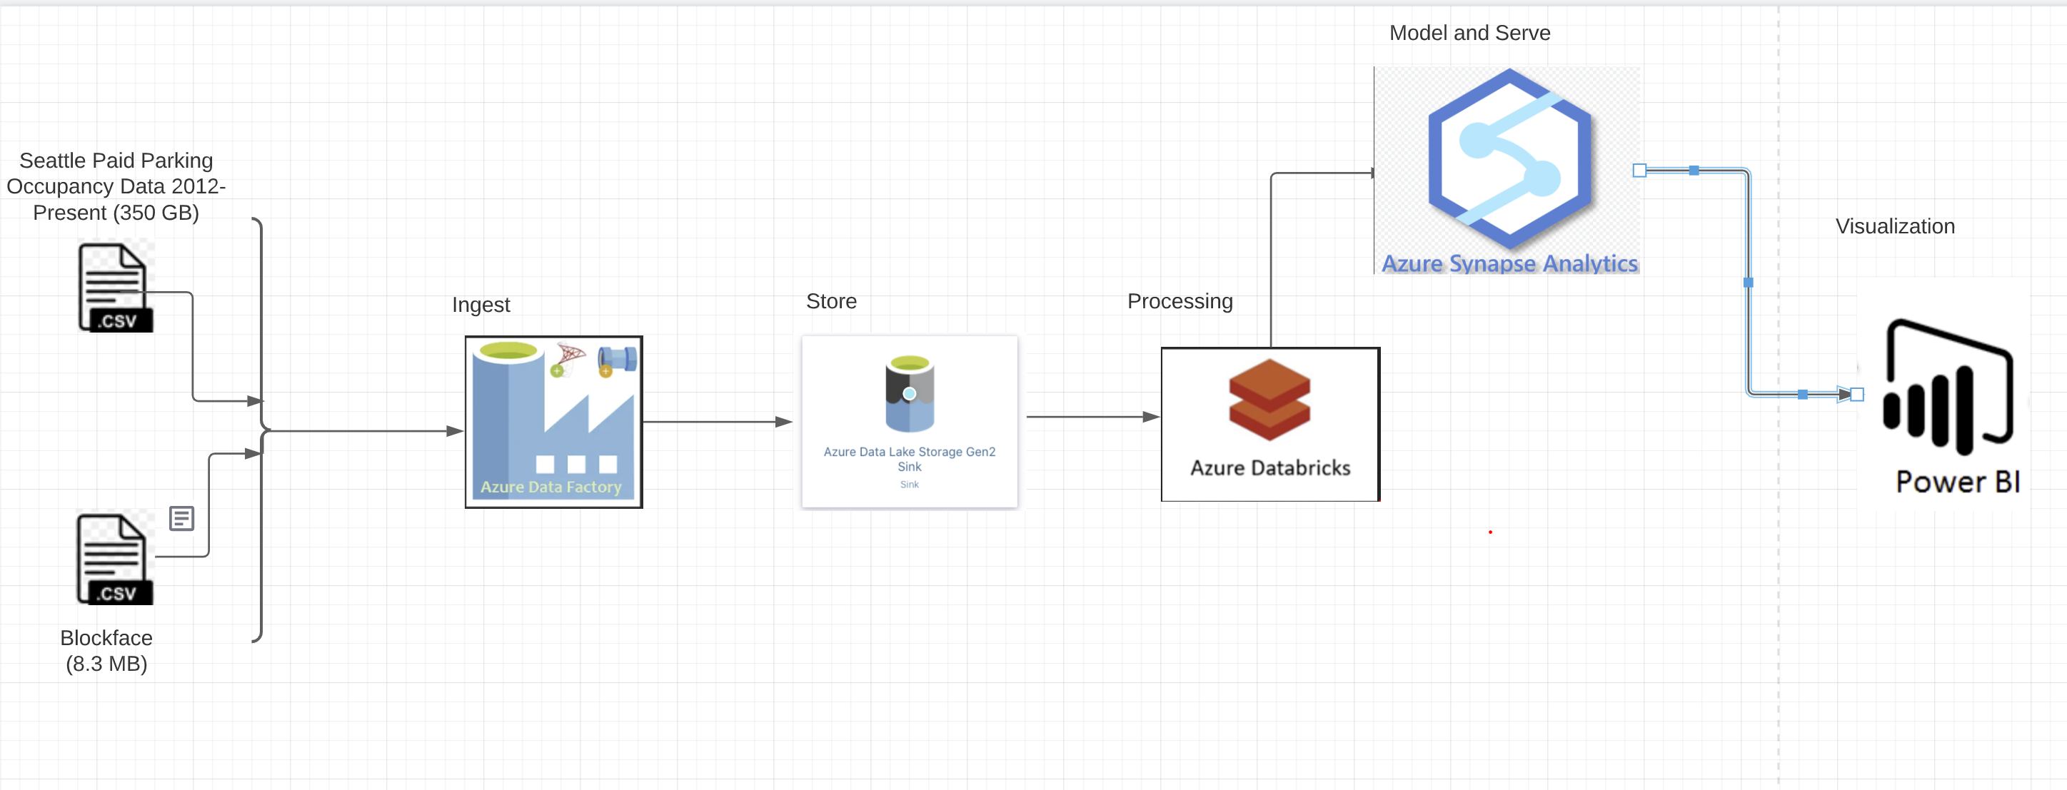
Cloud Architecture for Batch Processing
Data ingestion, processing, and visualization
Notes:
Data Source: Historical and Delta datasets for Seattle Paid Parking Occupancy from 2012-Present (about 350 GB) and Blockface stored in Azure Fileshare/Containers.
Azure Data Factory: To Ingest the data from Storage Account Fileshare/Container to Azure Data Lake.
Azure Databricks: A data analytics platform to process big data using Spark. For a big data pipeline, the data (raw or structure) is ingested into Azure Data Lake through Azure Data Factory in batches and processed using Spark in Azure Databricks.
Azure Synapse Analytics: Azure Synapse Analytics is an analytics service that brings together enterprise data warehousing and Big Data analytics.
Power BI: A Synapse Integrated feature to visualize the data.
Azure Data Factory to orchestrate entire data pipeline.

Slide 8
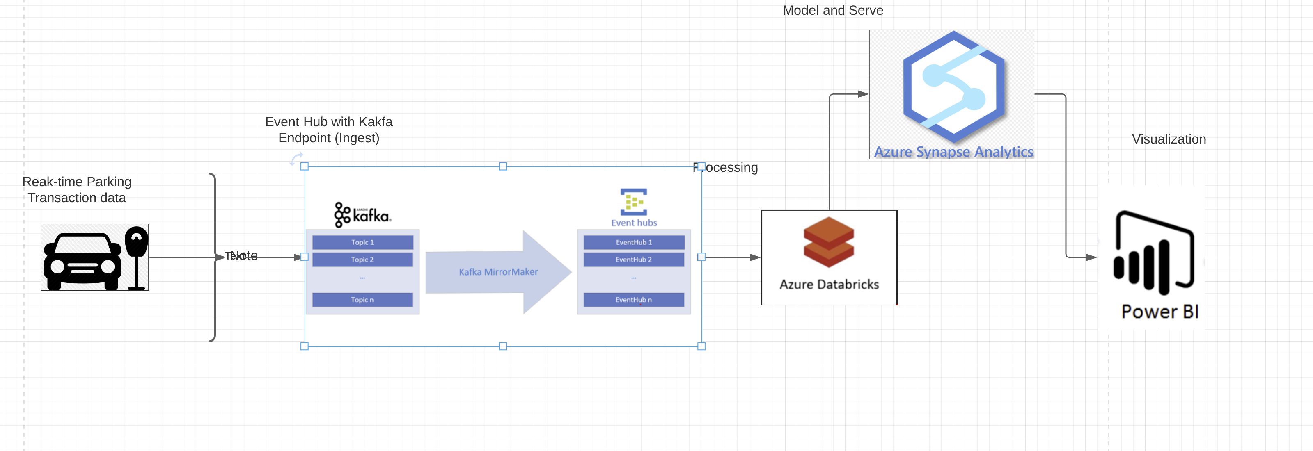
Cloud Architecture for Real-time Processing
Data ingestion, processing, and visualization
Notes:
Data Source: Transaction data available in real-time
Event Hubs with Kafka endpoint: The Event Hubs for Kafka feature provides a protocol head on top of Azure Event Hubs that is binary compatible with Kafka versions 1.0 and later for both reading from and writing to Kafka topics.
Azure Databricks: A data analytics platform to process big data using Spark. For a data pipeline, the data (raw or structure) is ingested into Azure through Azure Data Factory streamed near real-time using Apache Kafka.
Azure Synapse Analytics: Azure synapse is a limitless service to perform Big data analytics on processed data.
Power BI: Integrated solution to visualize the data.

Slide 9
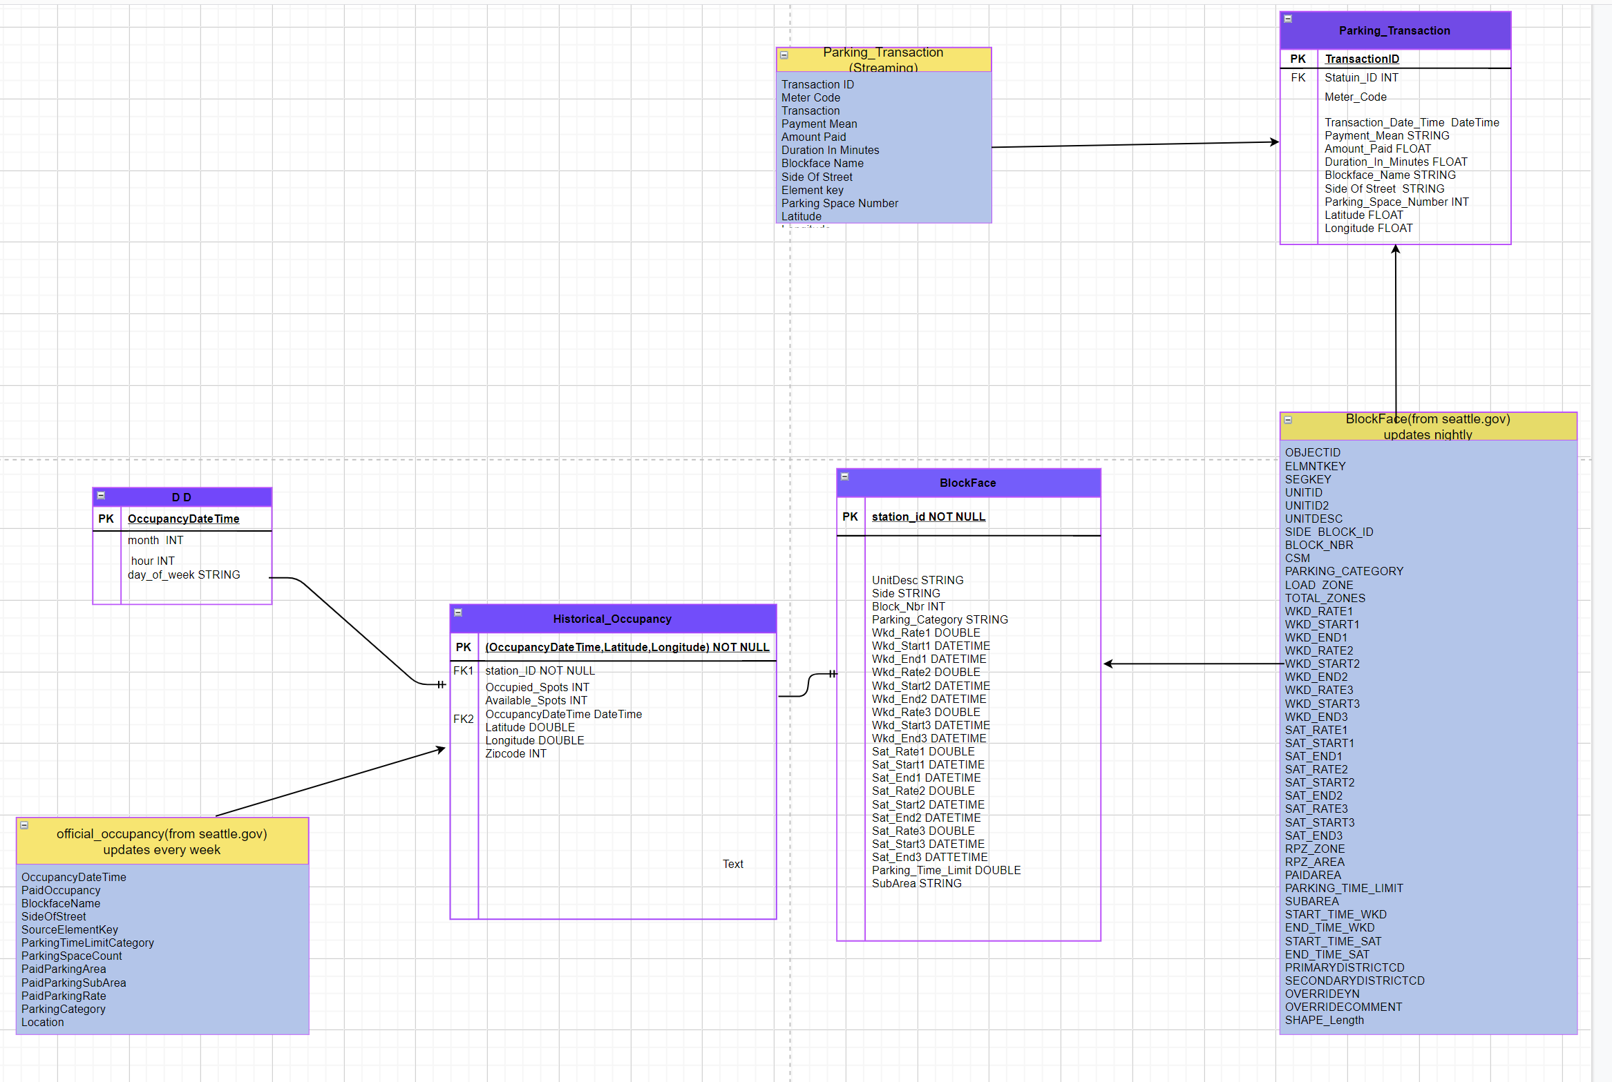
ER

